Slide 1
Data Communications

Slide 2
Error Detection and Correction
.

Slide 3
TYPES OF ERRORS
Data can be corrupted during transmission.
For reliable communication, errors must be detected and corrected.
Two types of errors:
  single-bit error
  burst errors.
.

Slide 4
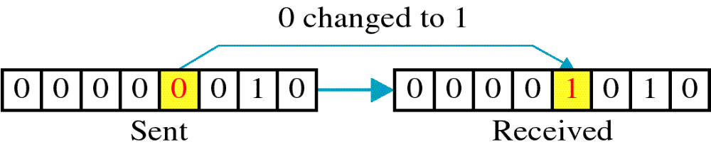
TYPES OF ERRORS
In a single-bit error, only one bit of a given data unit is changed from 1 to 0 or from 0 to 1.
.

Slide 5
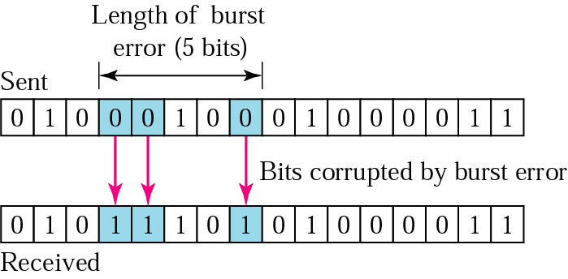
TYPES OF ERRORS
burst error: 2 or more bits in the data unit have changed from 1 to 0 or from 0 to 1.
A burst error does not mean that the errors occur in consecutive bits.
Length of the burst is measured from the first corrupted bit to the last corrupted bit
.

Slide 6
Redundancy
To detect or correct errors we need to send redundant bits with data.
These redundant bits are added by sender and removed by receiver.
Error detection uses the concept of redundancy, which means adding extra bits for detecting errors at the destination.
.

Slide 7
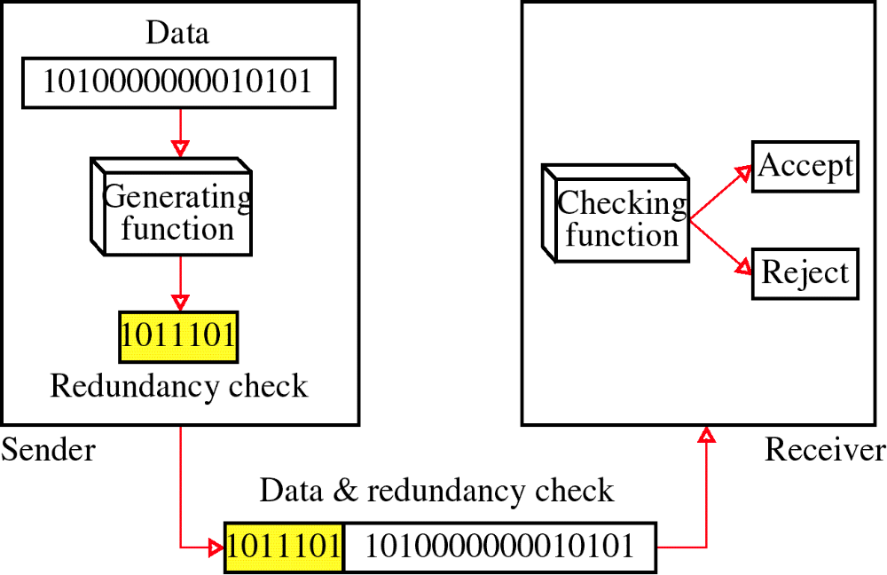
Redundancy
.

Slide 8
Detection Vs Correction
.

Slide 9
ERROR DETECTION
Data are transmitted as one or more contiguous sequences of bits, called frames.
Probabilities with respect to errors in transmitted frames:
P_{b} : Probability that a bit is received in error; known as bit error rate (BER)
P₁ : Probability that a frame arrives with no bit errors.
P₂ : Probability that, with an error-detecting algorithm in use, a frame arrives with one or more undetected errors.
P₃ : Probability that, with an error-detecting algorithm in use, a frame arrives with one or more detected bit errors but no undetected bit errors
.

Slide 10

ERROR DETECTION
First consider the case in which no means are taken to detect errors.
  Then the probability of detected errors (P₃) is zero.
Assume the probability that any bit is in error ( P_{b}) is constant and independent for each bit.
where F is the number of bits per frame.
.

Slide 11
ERROR DETECTION
The probability that a frame arrives with no bit errors decreases when the probability of a single bit error increases.
The probability that a frame arrives with no bit errors decreases with increasing frame length;
The longer the frame, the more bits it has and the higher the probability that one of these is in error.
.

Slide 12
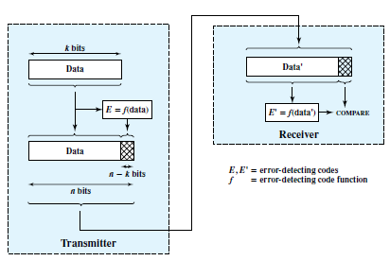
ERROR DETECTION
Error-detecting techniques operate on the following principle.
Figure 6.3 Error Detection Process
.

Slide 13
ERROR DETECTION
For a given frame of bits, additional bits that constitute an error-detecting code are added by the transmitter.
This code is calculated as a function of the other transmitted bits.
Typically, for a data block of k bits, the error-detecting algorithm yields an error-detecting code of ( n - k ) bits, where ( n – k ) < k
The error-detecting code, also referred to as the check bits, is appended to the data block to produce a frame of n bits, which is then transmitted.
.

Slide 14
ERROR DETECTION
The receiver separates the incoming frame into the k bits of data and (n – k) bits of the error-detecting code.
The receiver performs the same error-detecting calculation on the data bits and compares this value with the value of the incoming error-detecting code.
A detected error occurs if and only if there is a mismatch.
.

Slide 15
ERROR DETECTION
Thus P₃ is the probability that a frame contains errors and that the error-detecting scheme will detect that fact.
P₂ is known as the residual error rate and is the probability that an error will be undetected despite the use of an error-detecting scheme.
.

Slide 16
ERROR DETECTION
Parity Check
Simplest error-detecting scheme is to append a parity bit to the end of a block of data.
A typical example is character transmission, in which a parity bit is attached to each 7-bit character.
The value of this bit is selected so that the character has an even number of 1s (even parity) or an odd number of 1s (odd parity).
.

Slide 17
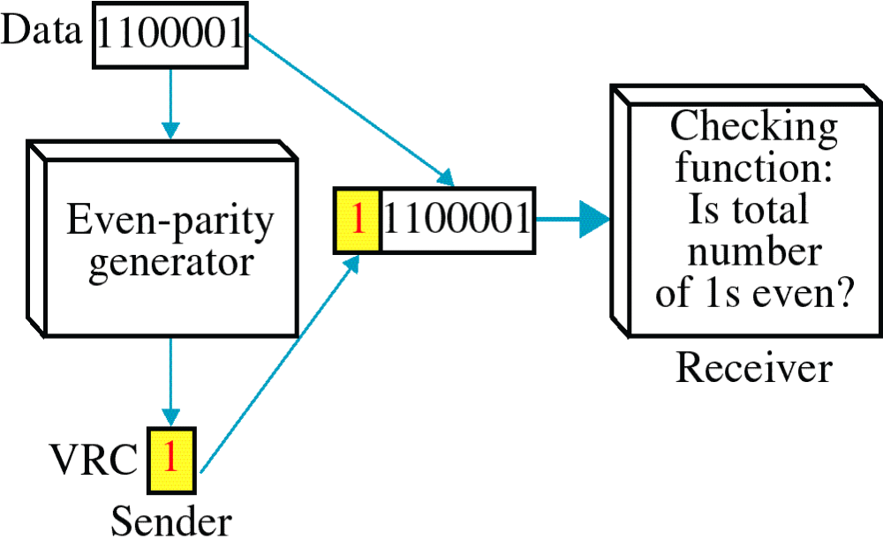
Vertical Redundancy Check VRC
.

Slide 18
Vertical Redundancy Check VRC
It can detect single bit error
It can detect burst errors only if the total number of errors is odd.
If two (or any even number) of bits are inverted due to error, an undetected error occurs.
.

Slide 19
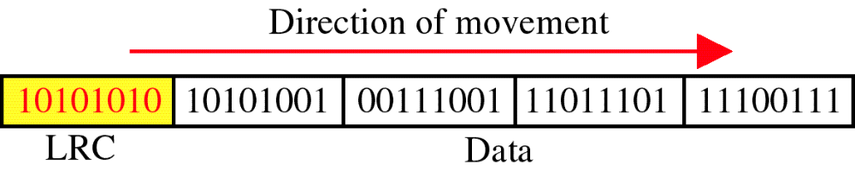
Longitudinal Redundancy Check LRC
.

Slide 20
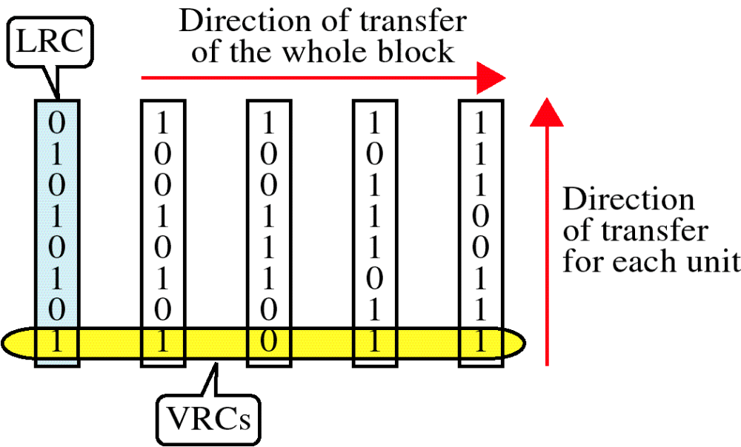
Longitudinal Redundancy Check LRC
.

Slide 21
Longitudinal Redundancy Check LRC
LRC increases the likelihood of detecting burst errors.
If two bits in one data units are damaged and two bits in exactly the same positions in another data unit are also damaged, the LRC checker will not detect an error.
.

Slide 22
ERROR DETECTION
Cyclic Redundancy Check (CRC)
One of the most common, and most powerful, error-detecting codes.
Given a k-bit block of bits, the transmitter generates an (n – k) bit sequence, known as a frame check sequence (FCS), such that the resulting frame, consisting of n bits, is exactly divisible by some predetermined number.
The receiver then divides the incoming frame by that number and, if there is no remainder, assumes there was no error.
.

Slide 23
ERROR DETECTION
Cyclic Redundancy Check (CRC)
procedure in three equivalent ways:
  modulo 2 arithmetic,
  polynomials
  digital logic.
.

Slide 24

Cyclic Redundancy Check (CRC)
Modulo 2 Arithmetic :
uses binary addition with no carries, which is just exclusive-OR (XOR) operation.
Binary subtraction with no carries is also interpreted as the XOR operation:
For example
.

Slide 25
ERROR DETECTION
Cyclic Redundancy Check (CRC)
Modulo 2 Arithmetic :
T = n bit frame to be transmitted.
D = k bit block of data, or the first k bits of T
F = ( n – k ) bit FCS, the last ( n – k ) bits of T
P = pattern of n – k + 1 bits; this is the predetermined divisor.
We would like T/P to have no remainder. It should be clear that
T = 2^{n-k} D + F
That is, by multiplying D by 2^{n-k}, we have in effect shifted it to the left by n-k bits and padded out the result with zeros.
Adding F yields the concatenation of D and F, which is T.
.

Slide 26


Cyclic Redundancy Check (CRC)
Modulo 2 Arithmetic
We want T to be exactly divisible by P.
Suppose that we divide 2^{n-k}D by P
There is a quotient and a remainder.
In division is modulo 2, the remainder is always at least one bit shorter than the divisor.
We will use this remainder as our FCS. Then
.

Slide 27



Cyclic Redundancy Check (CRC)
Modulo 2 Arithmetic
Does this R satisfy our condition that T/P have no remainder?
To see that it does, consider
Substituting Equation (6.1), we have
Any binary number added to itself modulo 2 yields zero. so
There is no remainder, and therefore T is exactly divisible by P.
.

Slide 28
Cyclic Redundancy Check (CRC)
Modulo 2 Arithmetic
Thus, the FCS is easily generated: Simply divide 2^{n-k}D by P and use the (n-k) remainder as the FCS.
On reception, the receiver will divide T by P and will get no remainder if there have been no errors.
.

Slide 29
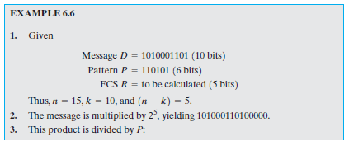
Cyclic Redundancy Check (CRC)
Modulo 2 Arithmetic
.

Slide 30
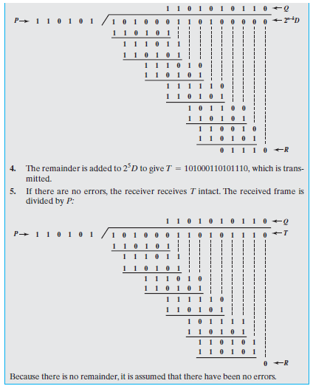
Cyclic Redundancy Check (CRC)
Modulo 2 Arithmetic
.

Slide 31
Cyclic Redundancy Check (CRC)
Modulo 2 Arithmetic
The pattern P is chosen to be one bit longer than the desired FCS, and the exact bit pattern chosen depends on the type of errors expected.
At minimum, both the high- and low-order bits of P must be 1.
.

Slide 32

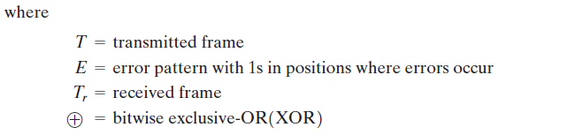
Cyclic Redundancy Check (CRC)
Modulo 2 Arithmetic
An error results in the reversal of a bit.
The resulting frame can be expressed as
.

Slide 33
Cyclic Redundancy Check (CRC)
Polynomials
A second way of viewing the CRC process is to express all values as polynomials in a dummy variable X, with binary coefficients.
The coefficients correspond to the bits in the binary number.
Thus, for we have and
for we have
.

Slide 34


Cyclic Redundancy Check (CRC)
Polynomials
Arithmetic operations are again modulo 2.
The CRC process can now be described as
Compare these equations with Equations (6.1) and (6.2).
.

Slide 35
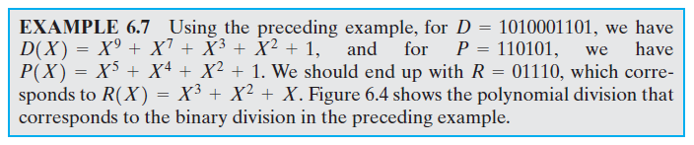
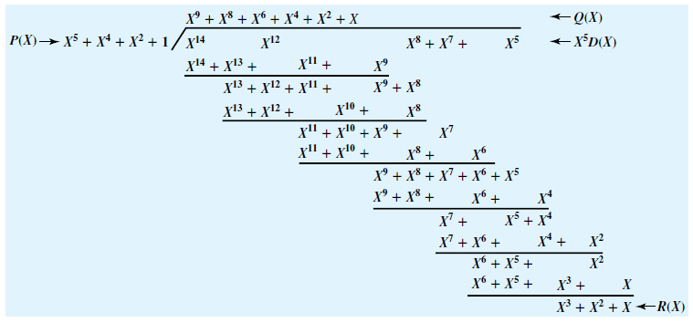
Cyclic Redundancy Check (CRC)
Polynomials
Figure 6.4 Example of Polynomial Division
.

Slide 36
Cyclic Redundancy Check (CRC)
Polynomials
An error E(X) will only be undetectable if it is divisible by P(X). It can be shown [PETE 61, RAMA88] that all of the following errors are not divisible by a suitably chosen P(X) and hence are detectable:
All single-bit errors, if P(X) has more than one nonzero term
All double-bit errors, as long as P(X) is a special type of polynomial, called a primitive polynomial, with maximum exponent L, and the frame length is less than 2^{L} - 1.
Any odd number of errors, as long as P(X) contains a factor
Any burst error for which the length of the burst is less than or equal to that is, less than or equal to the length of the FCS
A fraction of error bursts of length the fraction equals
A fraction of error bursts of length greater than the fraction equals
.

Slide 37
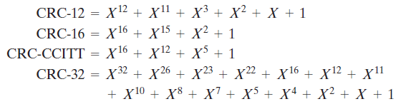
Cyclic Redundancy Check (CRC)
Polynomials
Four versions of P(X) are widely used:
.

Slide 38
Cyclic Redundancy Check (CRC)
Polynomials
The CRC-12 system is used for transmission of streams of 6-bit characters and generates a 12-bit FCS.
Both CRC-16 and CRC-CCITT are popular for 8-bit characters, in the United States and Europe, respectively, and both result in a 16-bit FCS.
This would seem adequate for most applications, although CRC-32 is specified as an option in some point-to-point synchronous transmission standards and is used in IEEE 802 LAN standards.
.

Slide 39
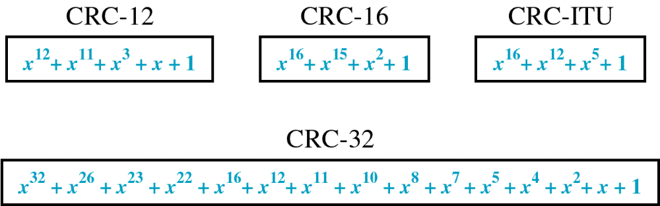
Cyclic Redundancy Check (CRC)
Polynomials
Standard Polynomials
.

Slide 40
Cyclic Redundancy Check (CRC)
Digital Logic
CRC process can be implemented as, a dividing circuit consisting of XOR gates and a shift register.
The shift register is a string of 1-bit storage devices.
Each device has an output line, which indicates the value currently stored, and an input line.
At discrete time instants, known as clock times, the value in the storage device is replaced by the value indicated by its input line.
The entire register is clocked simultaneously, causing a 1-bit shift along the entire register.
.

Slide 41
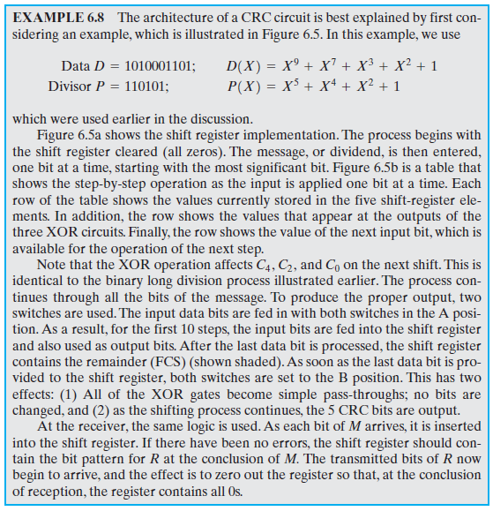
Cyclic Redundancy Check (CRC)
Digital Logic
.

Slide 42

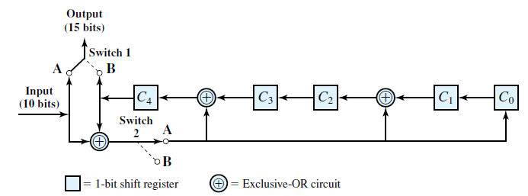
Cyclic Redundancy Check (CRC)
Digital Logic
The architecture of a CRC circuit
.

Slide 43
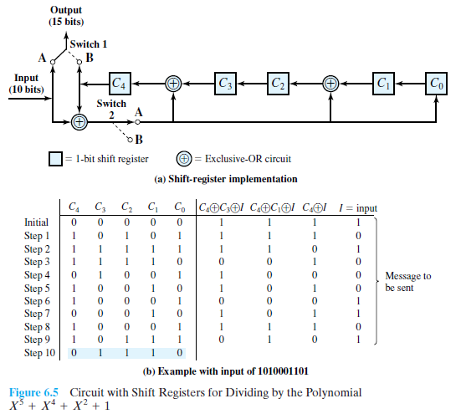
Cyclic Redundancy Check (CRC)
Digital Logic
Figure 6.5b is a table shows the step-by-step operation as the input is applied one bit at a time.
.

Slide 44
.

